Slide 1
RESUME PARSER WITH NLP
BY
ARULRAJ S (18MX203)
BALA RAJENDRA KUMAR R A (19MX151)
PROJECT GUIDE: Ms. K.GAYATHRI

Slide 2
AGENDA
OBJECTIVE
EXISTING SYSTEM
PROPOSED SYSTEM
COMMENTS OF REVIEW 0
SYSTEM FLOW
OUTPUT
USER INTERFACE DESIGN

Slide 3
OBJECTIVE
To design a model that can parse information from unstructured resumes and transform it to a structured JSON format.
Extract resume information based on the constraints given in the job description.

Slide 4
EXISTING SYSTEM
Various job portals.
Candidate must Sign Up.
Manually fill a form for his/her personal details.
Candidate have to upload their resume.
It is a time consuming process.
There is no standard format for the resume.
Resumes are written in different format that make difficult.

Slide 5
PROPOSED SYSTEM
Resume parser eliminate difficulties arising in the existing system.
candidate has to upload only the resume.
No need to fill the details again.
Once it is uploaded, it will be parsed and then transformed into a standardized format.
The candidate can upload resume in multiple formats like .docx, .txt, .pdf
The system will go through all the resumes and suggest the eligible candidates based on the constraints and display it to the concerned authority.

Slide 6
COMMENTS OF REVIEW 0
What Algorithm will be applied for parsing?
Entity Recognition ( also called as Named Entity Recognition(NER)).
EE is subtask of information extraction process.
Helps to identify the named entities in text into different types of facts
Helps in transformation of un-structured text to structured text

Slide 7
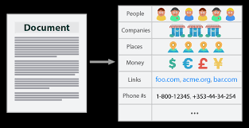
ENTITY EXTRACTION EXAMPLE

Slide 8
Contd..
Structured Resumes vs Unstructured Resumes?
There are no standard format for resume
Each one will write resume in their own way
Resume can be in any format.

Slide 9
Contd...
How the parser map the different format of resumes?
Resume parser can support 3 formats (.docx,.pdf,.txt)
All 3 formats converted into text format
.docx=docx2txt
.pdf =PyPDF2
Text format

Slide 10
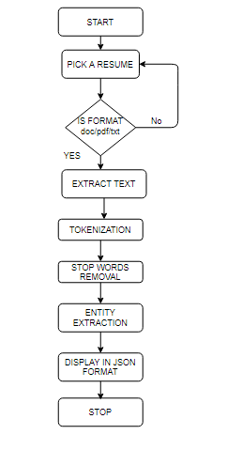
SYSTEM FLOW

Slide 11
UPLOAD FILE
from flask import Flask
UPLOAD_FOLDER = F:/SEMESTER4/MINI_PROJECT/pdf_to_text/Uploads'
app = Flask(__name__)
app.config['UPLOAD_FOLDER'] = UPLOAD_FOLDER
app.config['MAX_CONTENT_LENGTH'] = 16 * 1024 * 1024

Slide 12
CONVERTING PDF FILES INTO TEXT
import PyPDF2
if(ext==".pdf"):
pdfFileObj = open(filename, 'rb')
pdfReader = PyPDF2.PdfFileReader(pdfFileObj)
x=pdfReader.numPages
for i in range(1,x):
pageObj = pdfReader.getPage(i)
ans=pageObj.extractText()
content=content+ans

Slide 13
CONVERTING DOCUMENT INTO TEXT
import docx2txt
if(ext==".docx"):
content = docx2txt.process(filename)
if(ext==".txt"):
tfobj=open(filename,'r')
content=tfobj.read()

Slide 14
TOKENIZATION
In Python Tokenization basically refers to splitting up a larger body of text into smaller lines, words or even creating words for a non-English language.
The various tokenization functions in-built into the nltk module itself.
from nltk.tokenize import word_tokenize
word_tokens = word_tokenize(content)

Slide 15
STOPWORD REMOVAL
In natural language processing, useless words (data), are referred to as stop words.
A stop word is a commonly used word (such as “the”, “a”, “an”, “in”)
Stop words also consume memory space in Database
Stop words are the English words which does not add much meaning to a sentence.
They can safely be ignored without sacrificing the meaning of the sentence.
Such words are already captured this in corpus named corpus.

Slide 16
STOPWORDS IN NLP
{‘ourselves’, ‘hers’, ‘between’, ‘yourself’, ‘but’, ‘again’, ‘there’, ‘about’, ‘once’, ‘during’, ‘out’, ‘very’, ‘having’, ‘with’, ‘they’, ‘own’, ‘an’, ‘be’, ‘some’, ‘for’, ‘do’, ‘its’, ‘yours’, ‘such’, ‘into’, ‘of’, ‘most’, ‘itself’, ‘other’, ‘off’, ‘is’, ‘s’, ‘am’, ‘or’, ‘who’, ‘as’, ‘from’, ‘him’, ‘each’, ‘the’, ‘themselves’, ‘until’, ‘below’, ‘are’, ‘we’, ‘these’, ‘your’, ‘his’, ‘through’, ‘don’, ‘nor’, ‘me’, ‘were’, ‘her’, ‘more’, ‘himself’, ‘this’, ‘down’, ‘should’, ‘our’, ‘their’, ‘while’, ‘above’, ‘both’, ‘up’, ‘to’, ‘ours’, ‘had’, ‘she’, ‘all’, ‘no’, ‘when’, ‘at’, ‘any’, ‘before’, ‘them’, ‘same’, ‘and’, ‘been’, ‘have’, ‘in’, ‘will’, ‘on’, ‘does’, ‘yourselves’, ‘then’, ‘that’, ‘because’, ‘what’, ‘over’, ‘why’, ‘so’, ‘can’, ‘did’, ‘not’, ‘now’, ‘under’, ‘he’, ‘you’, ‘herself’, ‘has’, ‘just’, ‘where’, ‘too’, ‘only’, ‘myself’, ‘which’, ‘those’, ‘i’, ‘after’, ‘few’, ‘whom’, ‘t’, ‘being’, ‘if’, ‘theirs’, ‘my’, ‘against’, ‘a’, ‘by’, ‘doing’, ‘it’, ‘how’, ‘further’, ‘was’, ‘here’, ‘than’}

Slide 17
REMOVING STOPWORDS
import nltk
from nltk.corpus import stopwords
nltk.download('stopwords')
stop_words = set(stopwords.words('english'))
filtered_sentence = []
for w in word_tokens:
if w not in stop_words and w not in filtered_sentence:
filtered_sentence.append(w)
print(filtered_sentence)

Slide 18

MODEL RESUME

Slide 19
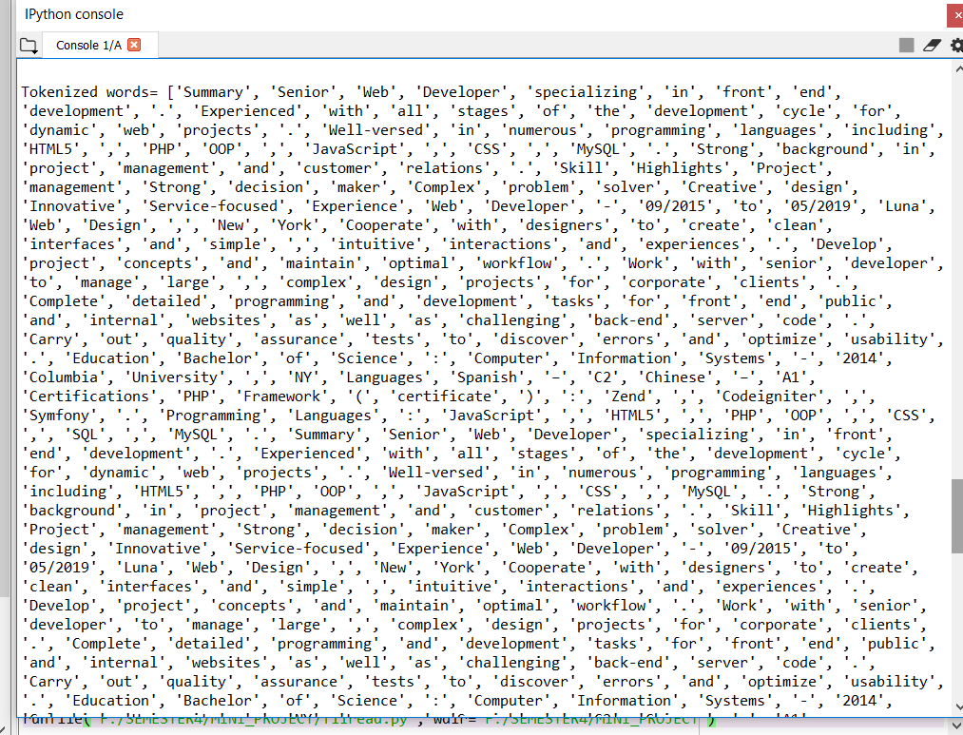
OUTPUT OF TOKENIZATION

Slide 20
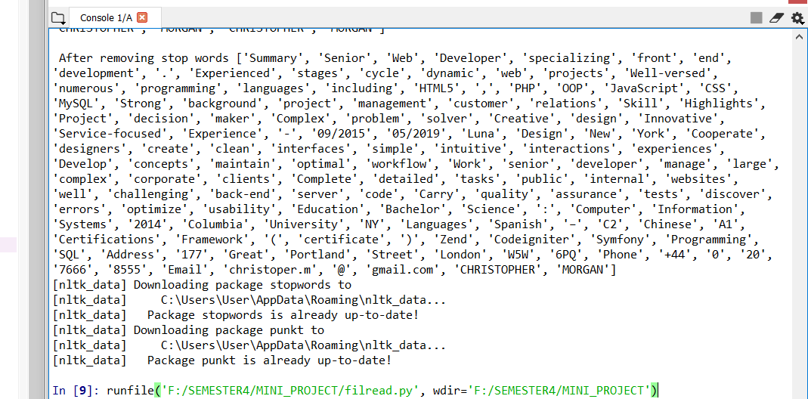
OUTPUT OF STOP WORDS REMOVAL

Slide 21
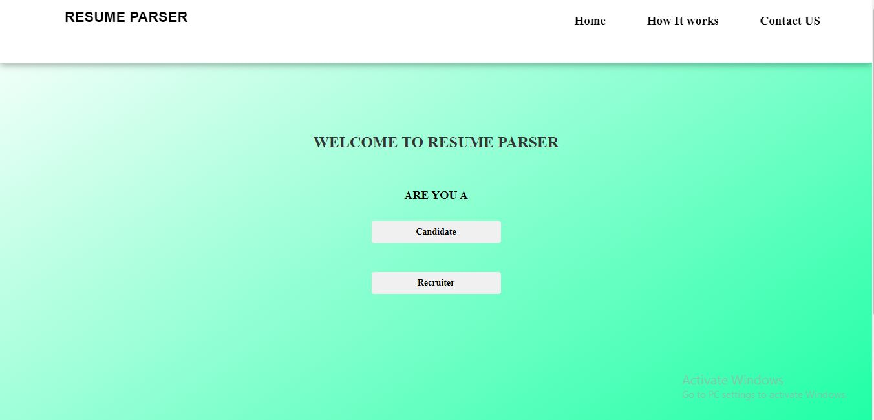
USER INTERFACE DESIGN

Slide 22
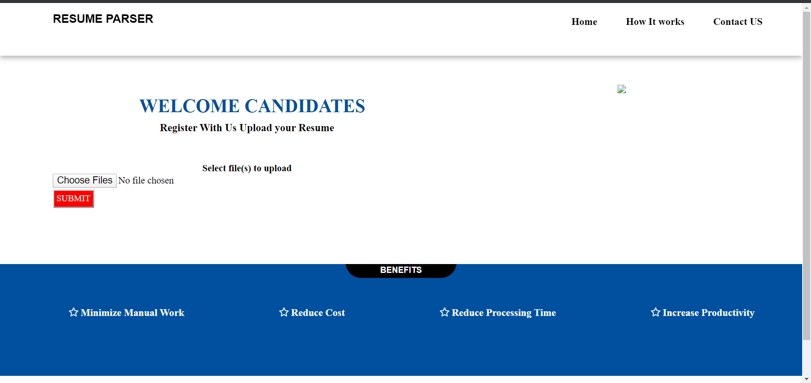

Slide 23
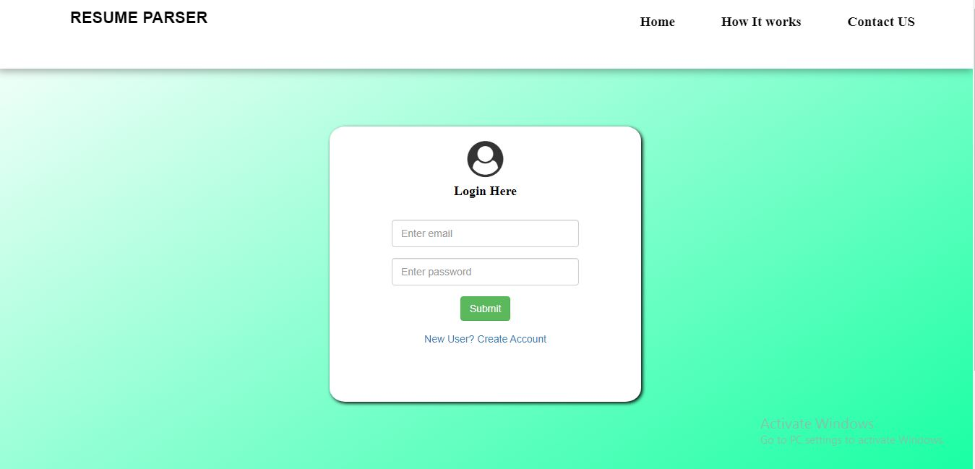

Slide 24
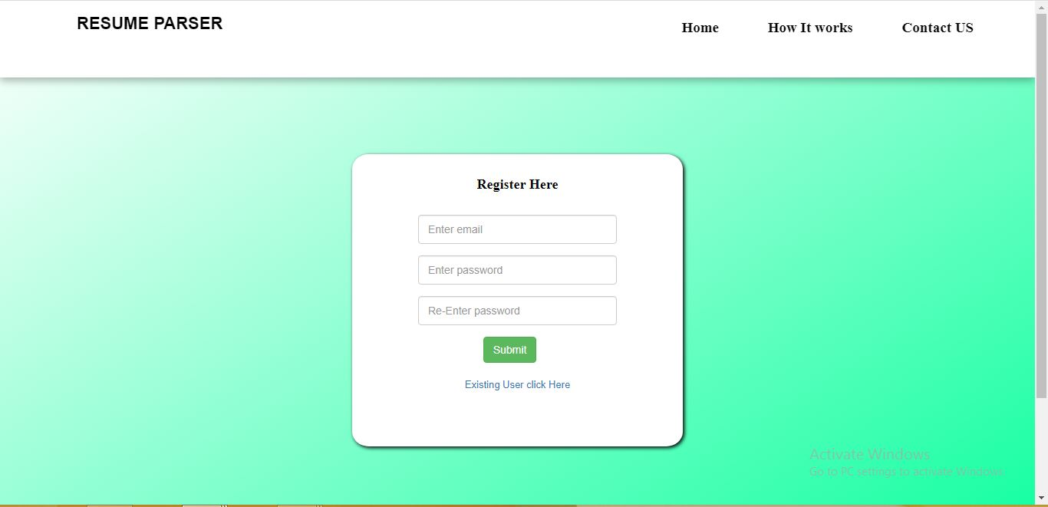

Slide 25


